Slide 1
Lecture 2 Frequency Principle/Spectral Bias
Zhi-Qin John Xu 许志钦
Shanghai Jiao Tong University
Wednesday, November 27, 2024

Slide 2
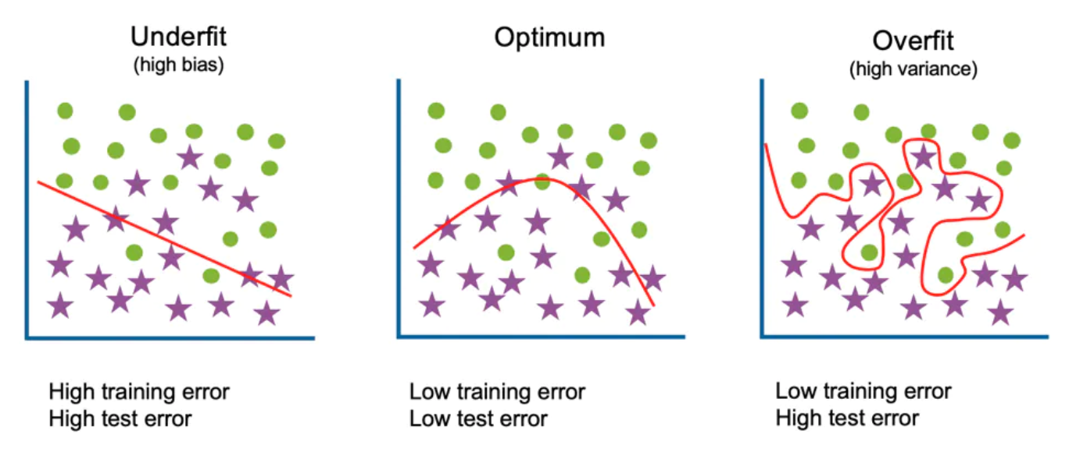
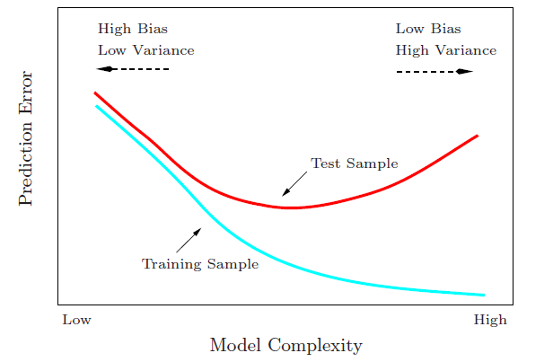
Start from traditional generalization gap
Large complexity → Large generalization gap
Generalization Gap
Traditional wisdom: Too complex is trouble

Slide 3
model: millions of parameters five data points
Overfitting??

Slide 4
DNN says: NO!

Slide 5
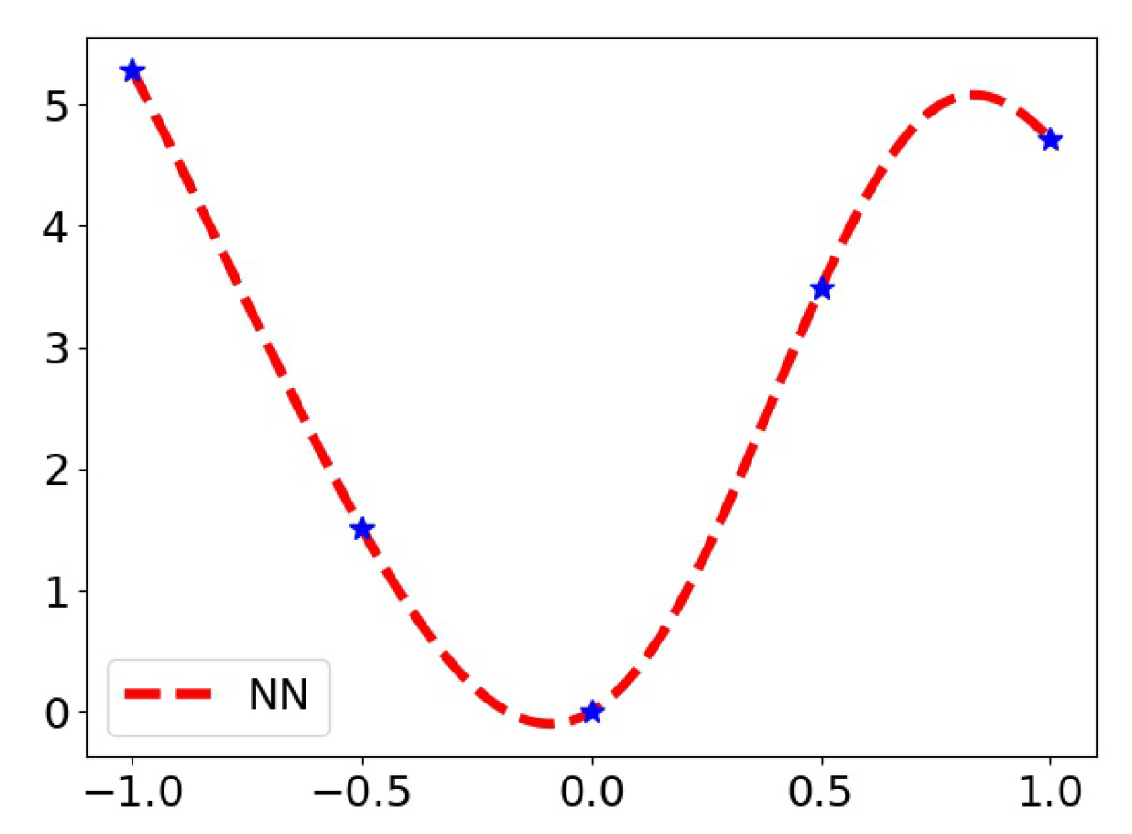
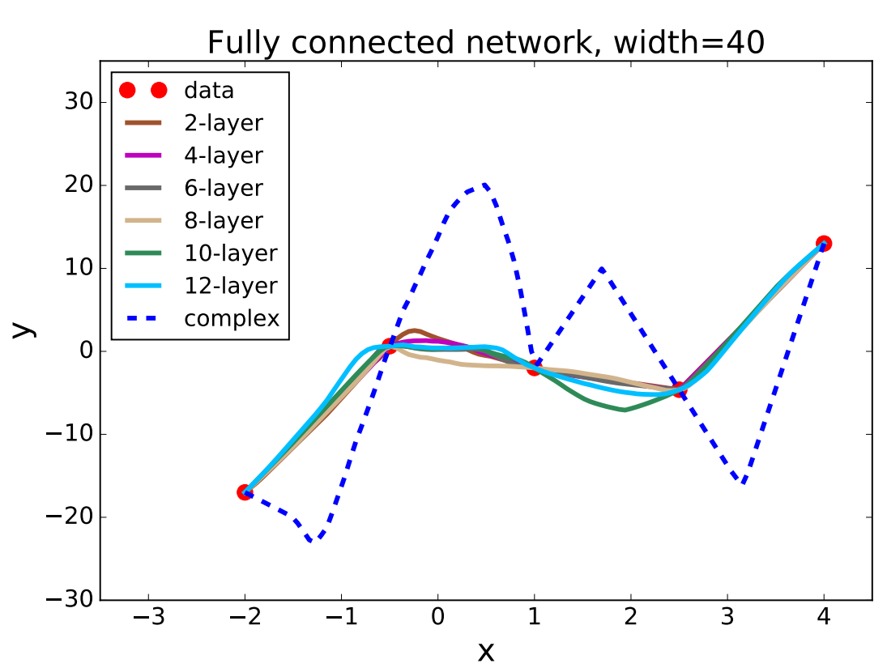
One-dimensional fitting
# of parameters: ~ 1600*Layer number>>5
Four hidden layer with width 500, tanh
Lei Wu et al., 2017

Slide 6
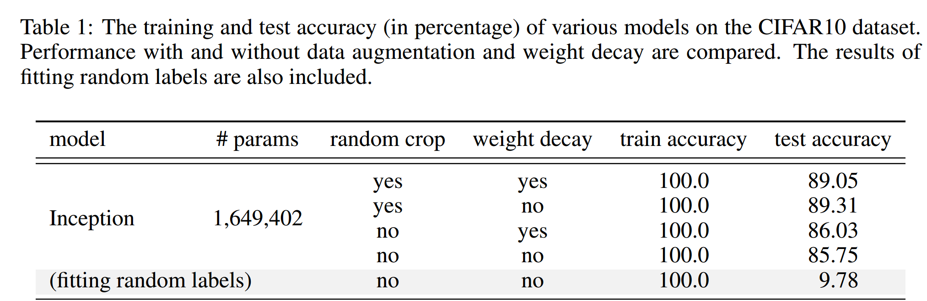
Overparameterization puzzle
Puzzle: generalize well even # of para >> # of training data
60000 32x32 colour images in 10 classes
This trouble ignores deep learning?
L. Breiman 1995, Zhang et al., 2016

Slide 7

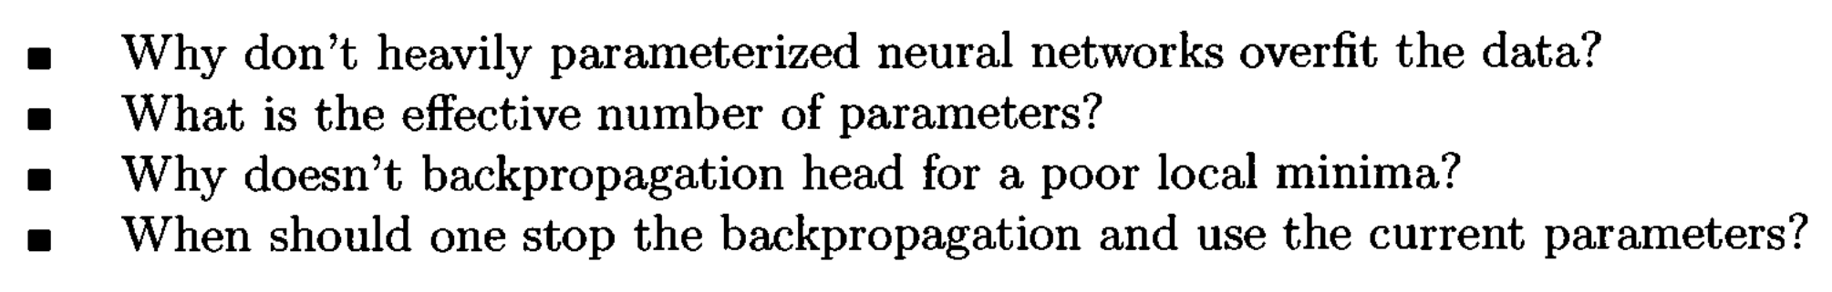
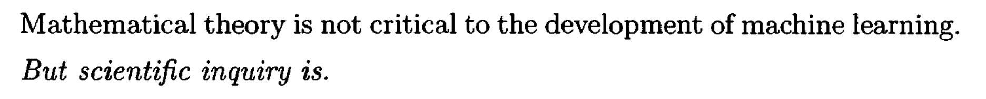
Long-standing problems
1995

Slide 8
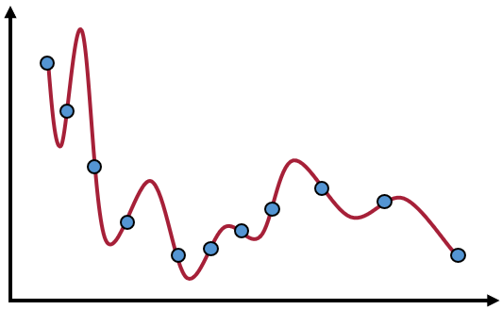
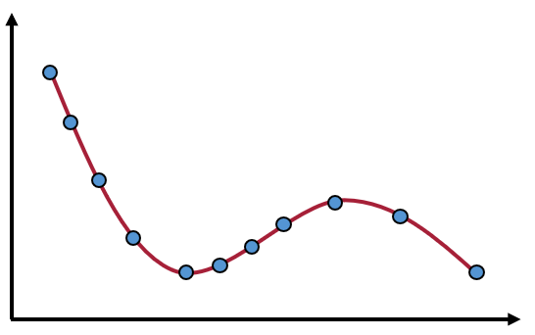
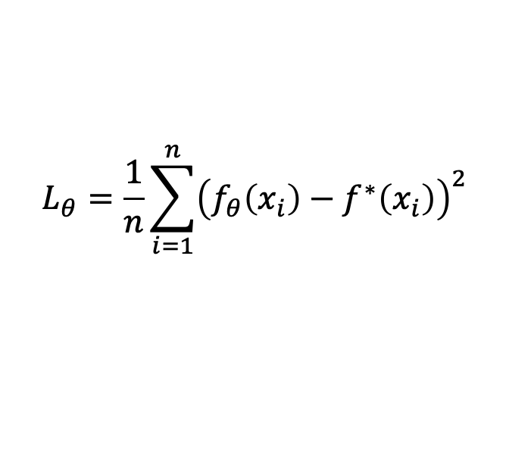
In our series：Implicit bias (regularization)
Loss=0：
……
Train
#para> #sample
Mul. Sol.
Sol. With good gen.
$$L_{θ}=\frac{1}{n}\sum_{i=1}^{n}{{\left(f_{θ}\left(x_{i}\right)−f^{∗}\left(x_{i}\right)\right)}^{2}}$$
But, no difference in loss function：
A key Question：
What is implicit bias of neural networks during training?

Slide 9
Real data is too complex!

Slide 10
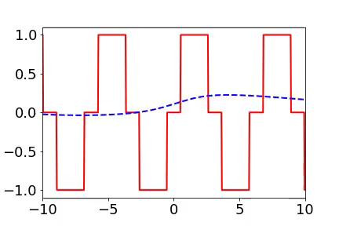
Training process of 1d example in spatial domain
From landscape to detail
Red:
target function
Blue:
DNN fitting
1807.01251

Slide 11
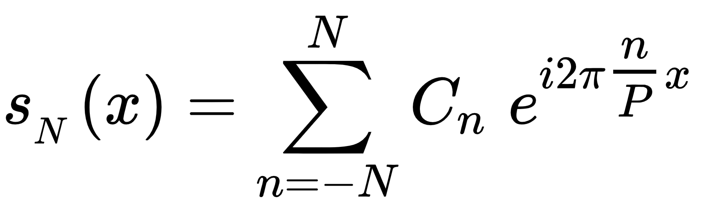
Frequency：Flatness、oscillation、outline、details

Slide 12
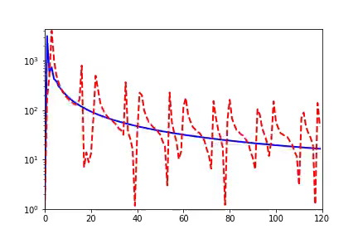
Training process of 1d example in Fourier domain
Frequency principle: From low frequency to high frequency
Red:
target function
Blue:
DNN fitting
Amplitude
Frequency
1807.01251

Slide 13
Training process of 1d example in Fourier domain
Frequency principle: From low frequency to high frequency
Red:
target function
Blue:
DNN fitting
Frequency
Or
Amplitude ?
Amplitude
Frequency
1807.01251

Slide 14
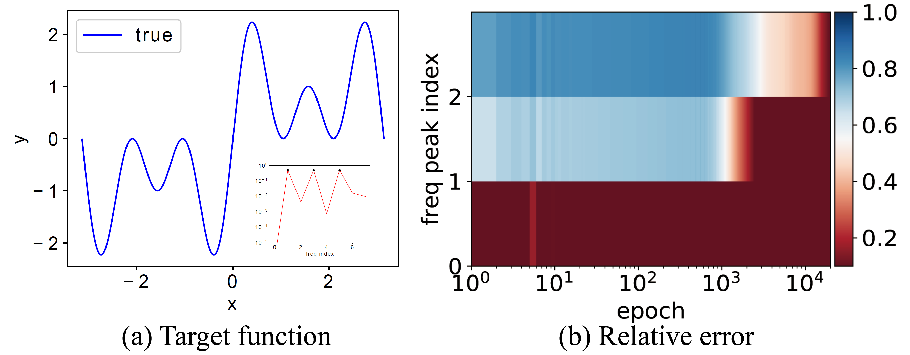
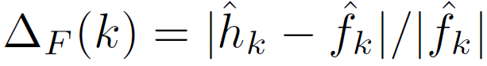
Important problems in this field
Equal amplitudes
$$f\left(x\right)=\sin{x}+\sin{3x}+\sin{5x}$$
1901.06523

Slide 15
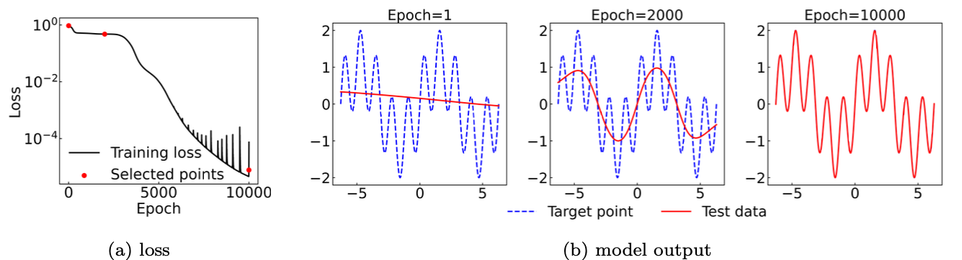
Spatial domain

Slide 16
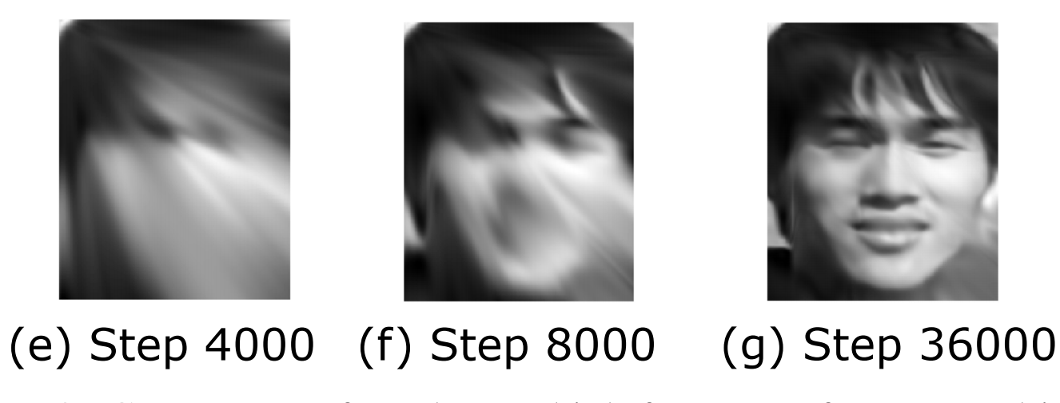
2d data

Slide 17
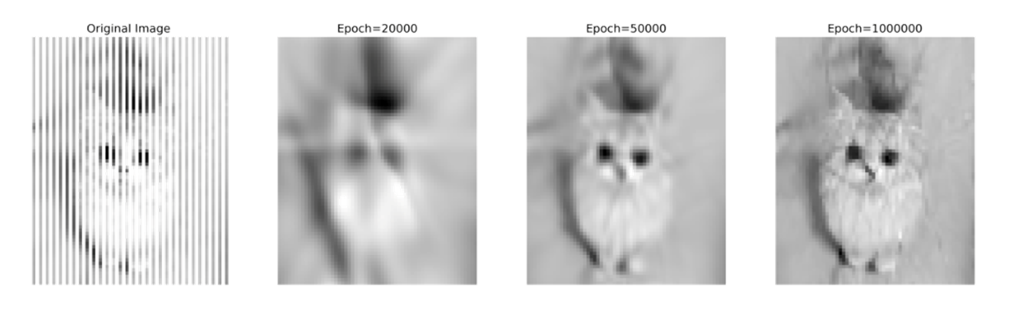
2d data

Slide 18
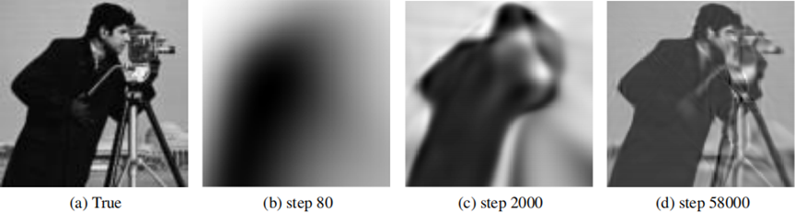
2d data

Slide 19
Understanding generalization

Slide 20
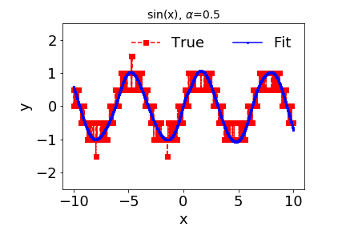
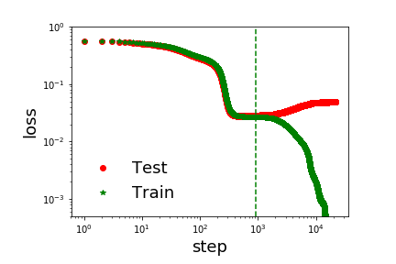
Effect of early stopping

Slide 21
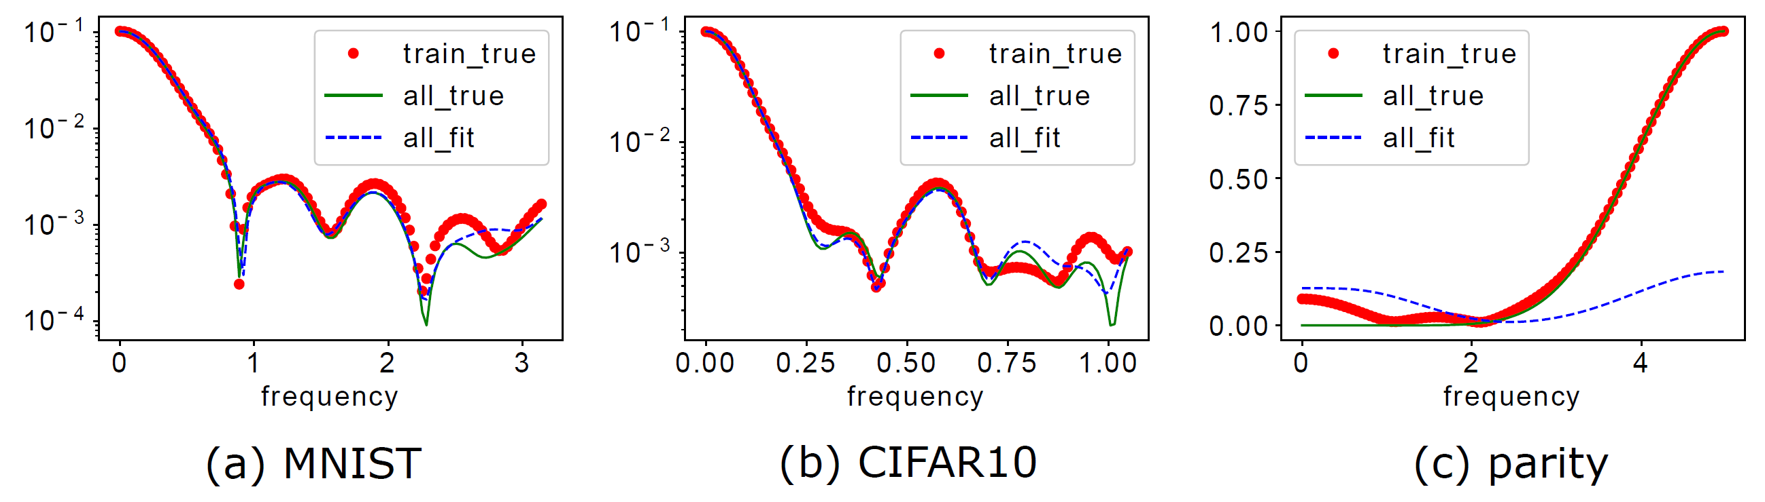
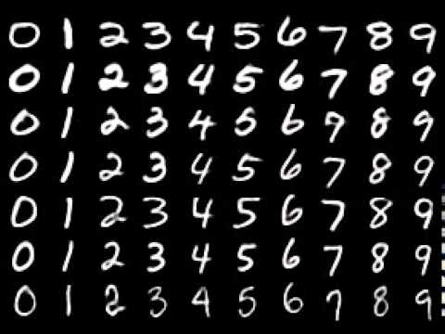
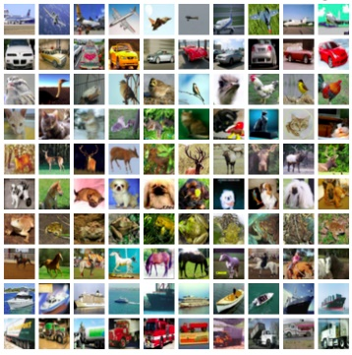
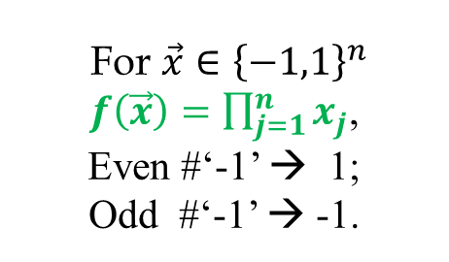
Generalization difference
F-Principe: DNN prefers low frequencies
For $\vec{x}∈{\left\{−1,1\right\}}^{n}$
$f\left(\vec{x}\right)=\prod_{j=1}^{n}{x_{j}}$,
Even #‘-1’ → 1;
Odd #‘-1’ → -1.
Test accuracy: 96.3%>>10%
Test accuracy: 72% %>>10%
Test accuracy: ~50%, random guess
1901.06523

Slide 22
Long-standing problems
1995
Frequency principle is independent of network size!
For many cases, early-stopping avoids fit high-frequency noise!
Leo Breiman, 1995

Slide 23
Why frequency principle?
Learn from low to high frequency

Slide 24
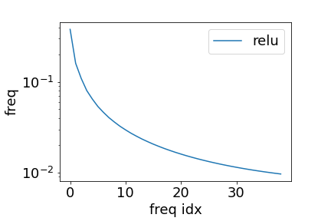
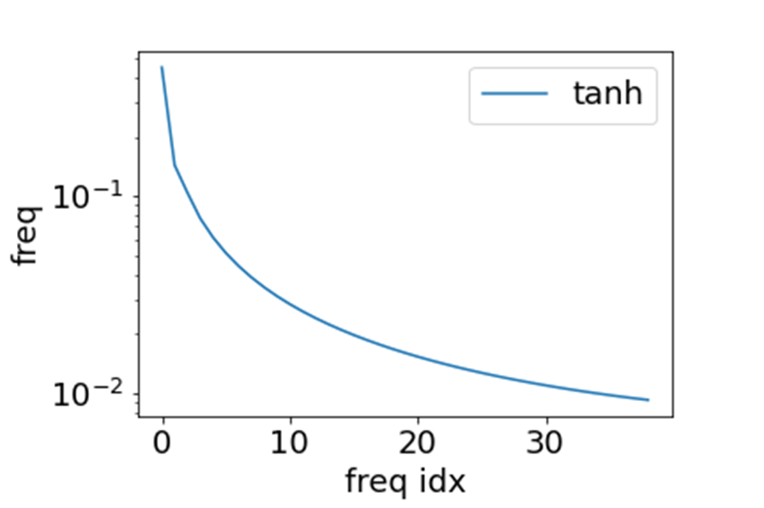
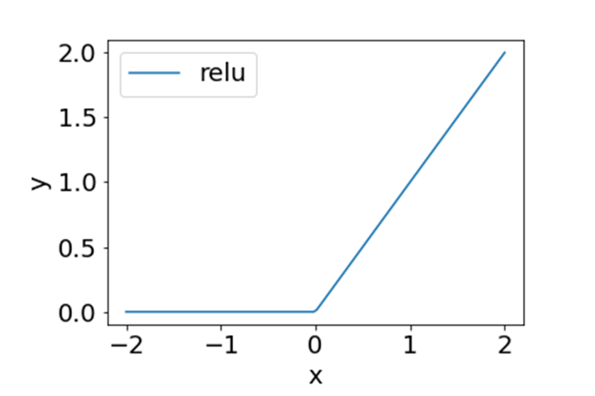
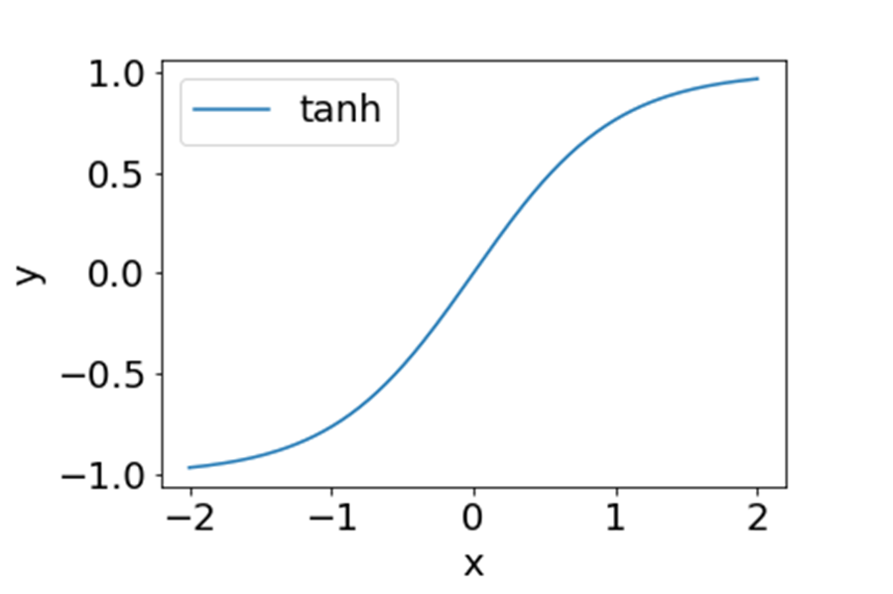
ReLU and Tanh in Fourier domain
Decay with frequency

Slide 25
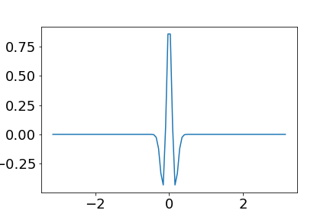
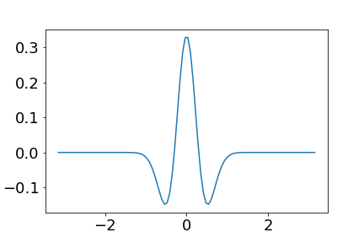
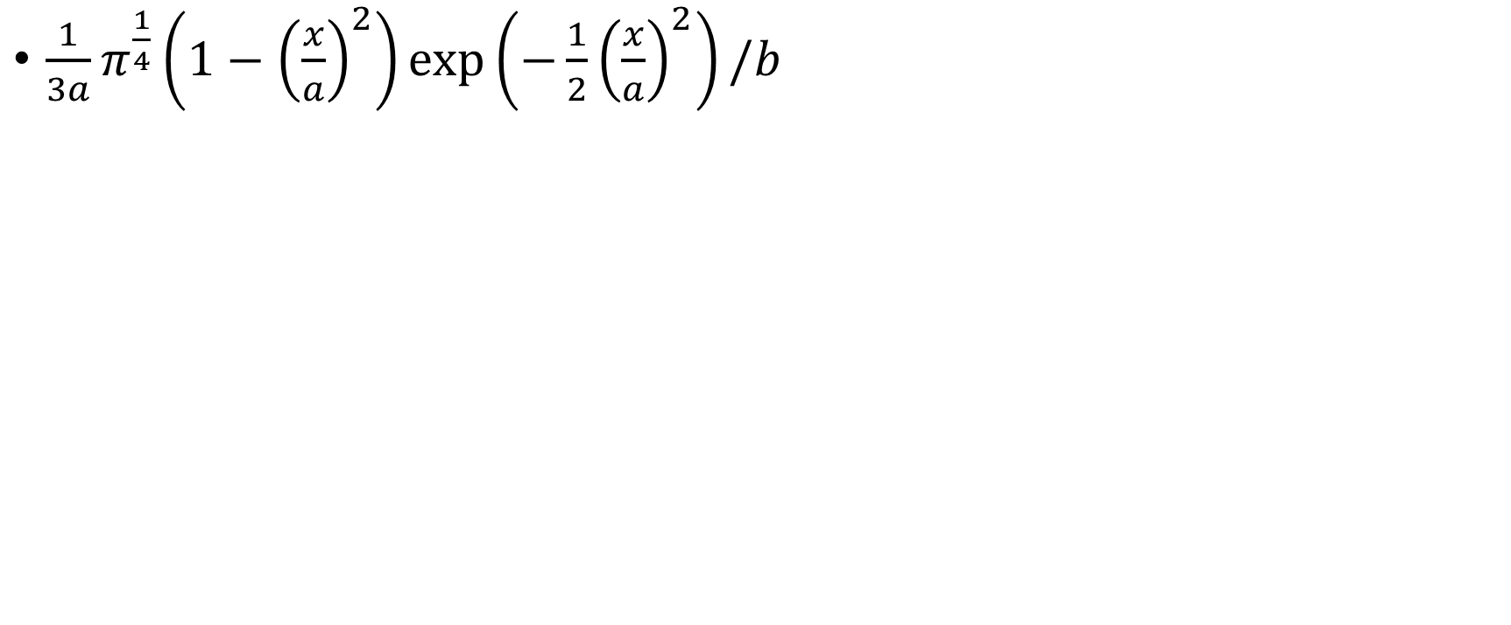


Activation function
$\frac{1}{3a}π^{\frac{1}{4}}\left(1−{\left(\frac{x}{a}\right)}^{2}\right)\exp\left(−\frac{1}{2}{\left(\frac{x}{a}\right)}^{2}\right)/b$
$$a=0.1, b=5$$
$$a=0.3, b=5$$

Slide 26
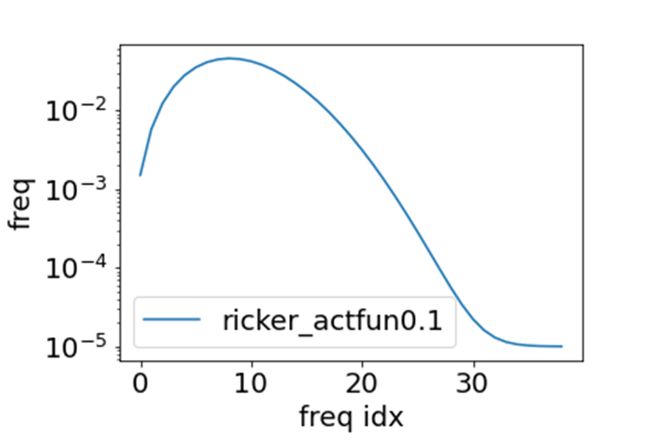
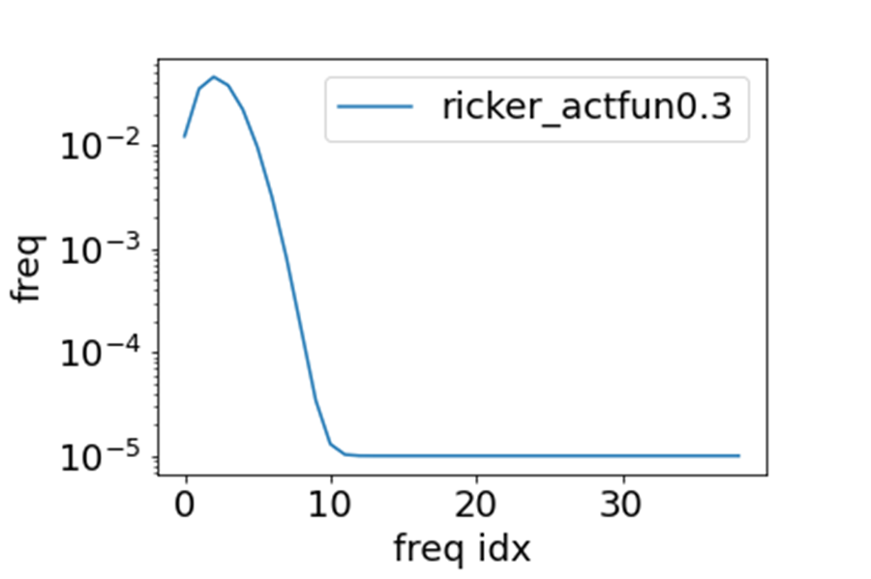
Activation function in Fourier domain
$\frac{1}{3a}π^{\frac{1}{4}}\left(1−{\left(\frac{x}{a}\right)}^{2}\right)\exp\left(−\frac{1}{2}{\left(\frac{x}{a}\right)}^{2}\right)/b$
$$a=0.1, b=5$$
$$a=0.3, b=5$$

Slide 27
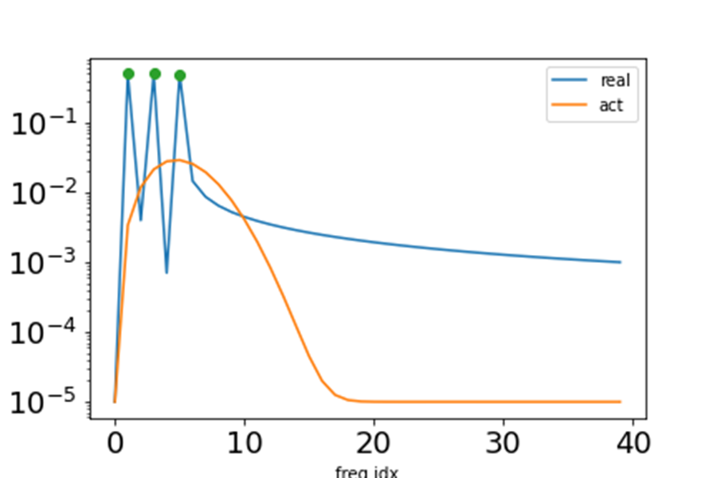
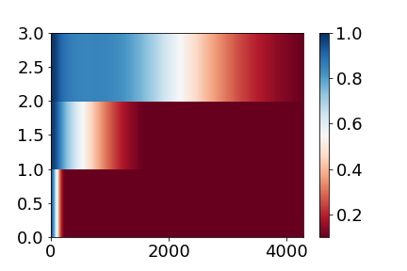
Clear Frequency principle
Low frequency faster
Relative error of three frequencies
Activation
Frequency domain
220908154157

Slide 28
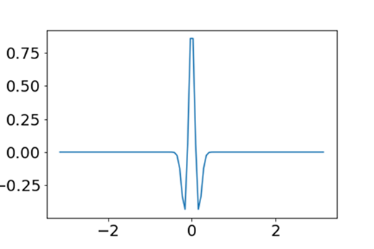
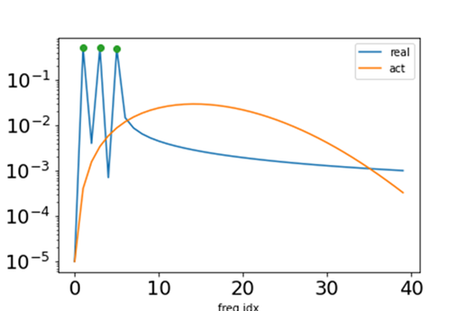
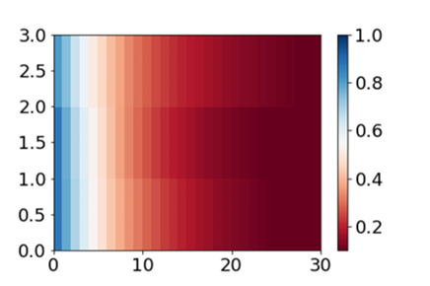
No Frequency principle
no frequency faster
Relative error of three frequencies
Activation
Frequency domain
220908154157

Slide 29
Key 1: the decay of activation in Fourier domain

Slide 30
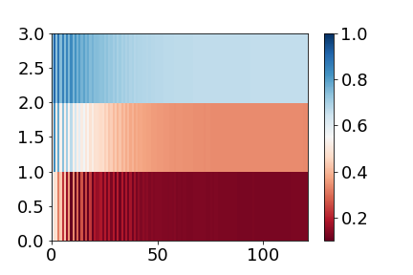
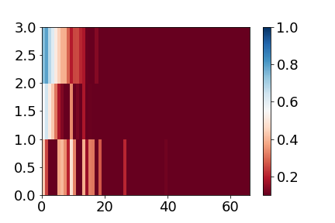
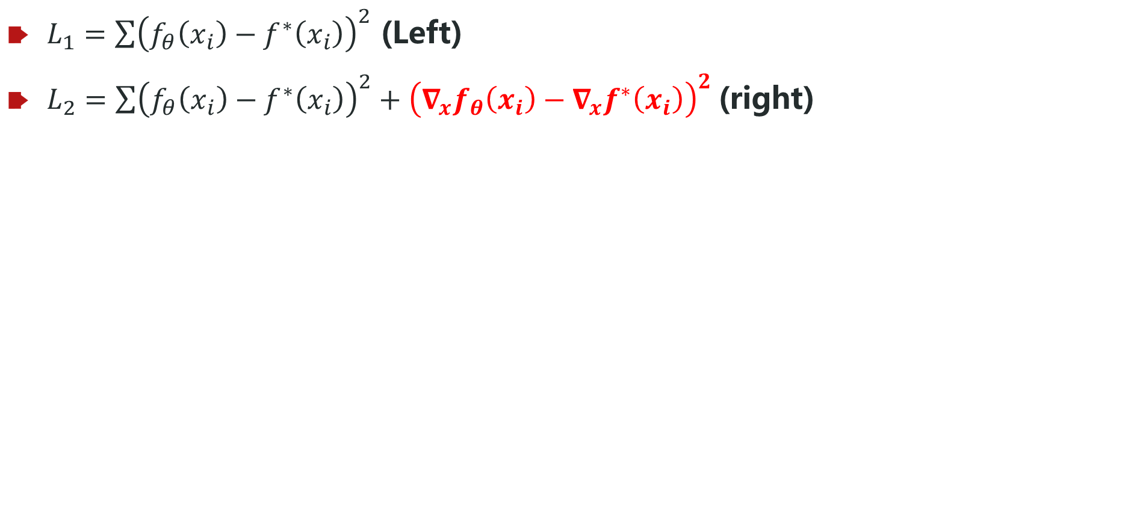
Gradient accelerates the high-freq speed
$L_{1}=\sum{{\left(f_{θ}\left(x_{i}\right)−f^{∗}\left(x_{i}\right)\right)}^{2}}$ (Left)
$L_{2}=\sum{{\left(f_{θ}\left(x_{i}\right)−f^{∗}\left(x_{i}\right)\right)}^{2}+{\left({∇_{x}f}_{θ}\left(x_{i}\right)−∇_{x}f^{∗}\left(x_{i}\right)\right)}^{2}}$(right)
ReLU, same target
[100, 200, 100]
Adam

Slide 31
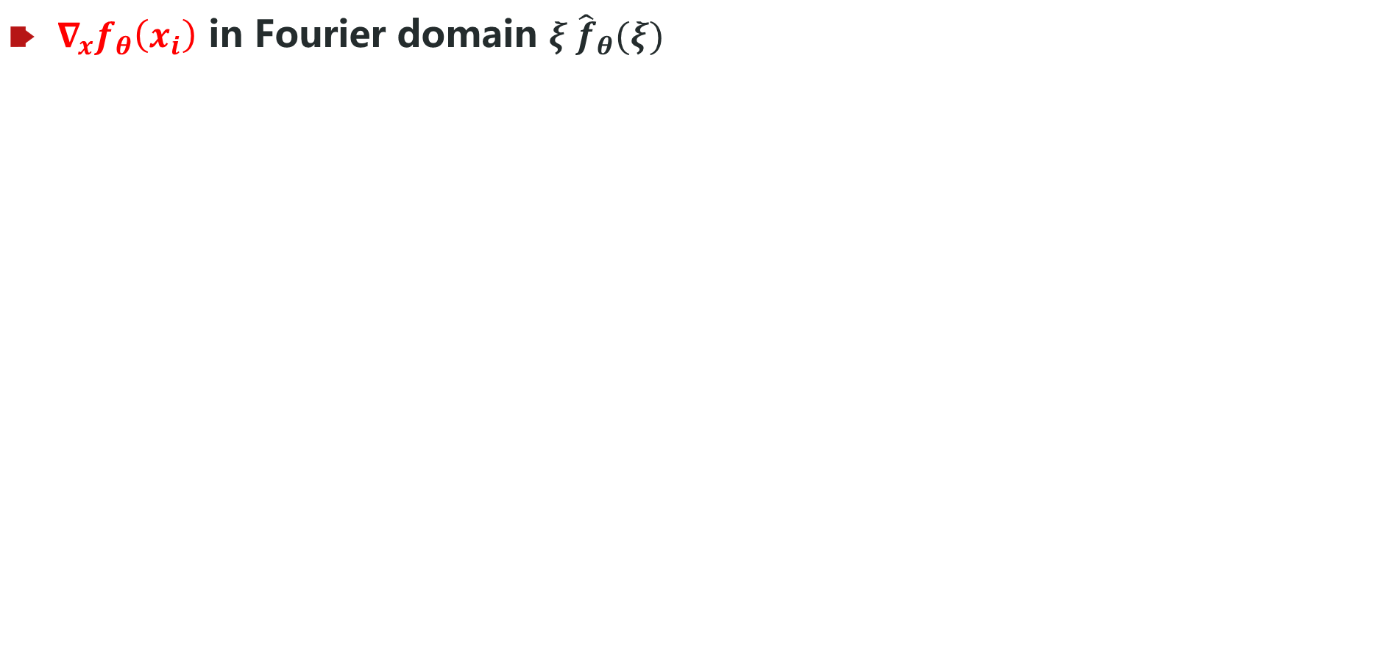
Gradient accelerates the high-freq speed
${∇_{x}f}_{θ}\left(x_{i}\right)$ in Fourier domain $ξ {\hat{f}}_{θ}(ξ)$
Equivalent to add more weight for high frequency

Slide 32
Key 2: the weight of frequency in loss function

Slide 33
Why we need frequency principle?
Zhi-Qin John Xu*, Yaoyu Zhang, Tao Luo,
Overview frequency principle/spectral bias in deep learning. arxiv 2201.07395 (2022)

Slide 34

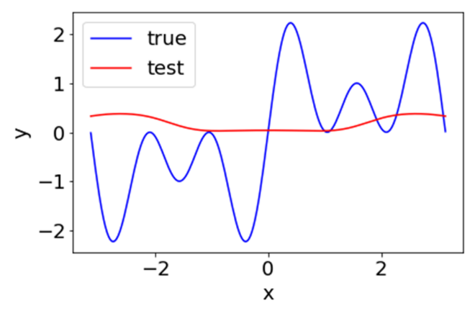
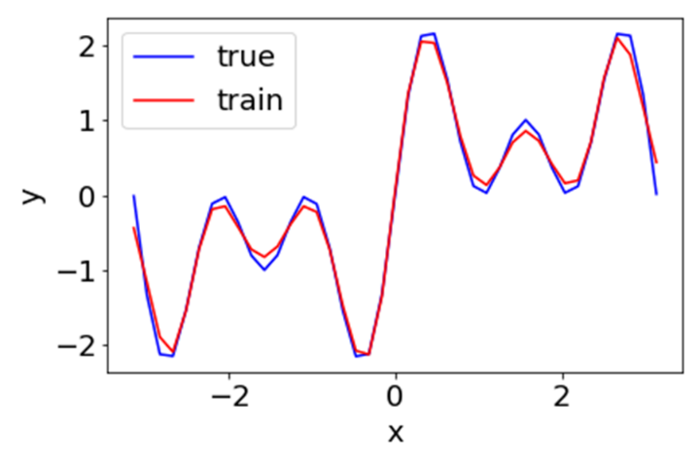
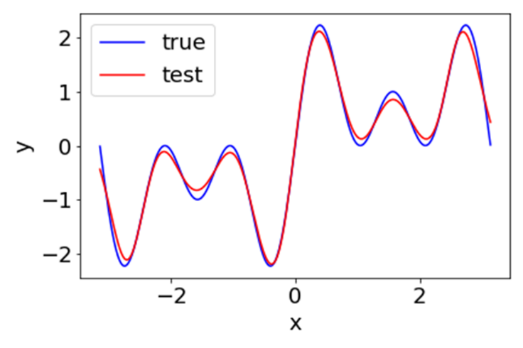
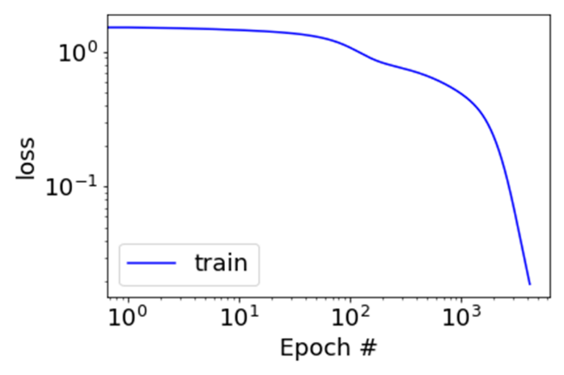
Clear Frequency principle, flat interpolation
Low frequency faster
Activation
Frequency domain
Initial epoch
Relative error of three frequencies
Final, training points
Final, test points
Loss
Zhi-Qin John Xu*, Yaoyu Zhang, Tao Luo,
Overview frequency principle/spectral bias in deep learning. arxiv 2201.07395 (2022)
220908154157

Slide 35


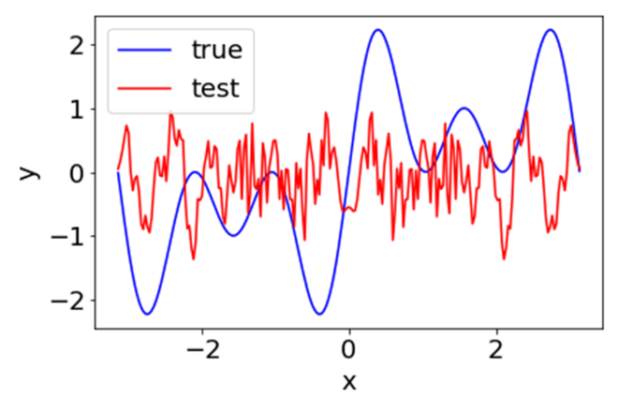

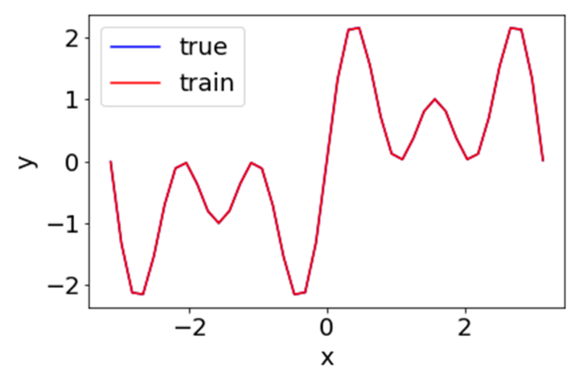
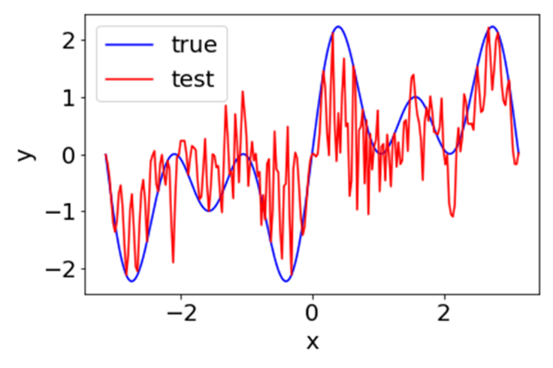

no Frequency principle, oscillated interpolation
No frequency faster
Activation
Frequency domain
Initial epoch
Relative error of three frequencies
Final, training points
Final, test points
Loss
Zhi-Qin John Xu*, Yaoyu Zhang, Tao Luo,
Overview frequency principle/spectral bias in deep learning. arxiv 2201.07395 (2022)
220911183904

Slide 36
Theory Understanding: one hidden layer, 1-d function

Slide 37



DNN: one hidden layer net
Consider a tanh-DNN of one-hidden layer for fitting a 1-d function $f$
$$h\left(x\right)=\sum_{j=1}^{m}{a_{j}σ\left(w_{j}x+b_{j}\right),}$$
$$\hat{h}\left(k\right)≈\sum_{j=1}^{m}{a_{j}\exp{(\frac{ib_{j}}{w_{j}})}\exp\left(−\left|\frac{πk}{2w_{i}}\right|\right) ,}$$
Define the loss at frequency $k$
$$L\left(k\right)=\frac{1}{2}{\left|\hat{h}\left(k\right)−\hat{f}\left(k\right)\right|}^{2}$$
By Parseval’s theorem: $L=\int{L\left(k\right)dk=∫\frac{1}{2}{\left|f\left(x\right)−h(x)\right|}^{2}dx}$
Compute the gradient by the loss in Fourier domain
$$θ←θ−η\sum{\frac{∂L\left(k\right)}{∂θ}}$$
1901.06523

Slide 38




DNN: one hidden layer net
$$\left|\frac{∂L(k)}{∂θ}\right|≈A\left(k\right)\exp\left(−\left|\frac{πk}{2w_{i}}\right|\right)G(θ,k)$$
high freq
Low freq
Where $A\left(k\right)=\left|\hat{h}\left(k\right)−\hat{f}\left(k\right)\right|$
$A\left(k\right)>0:$
If $w_{i}$ is small, $\exp{(−\left|πk/{2w}_{j}\right|)}$ dominate, low frequencies dominate.
For $w_{i}∈B_{δ}$, center at 0 with radius $δ$, if $δ$ is small, contribution of high frequency loss is negligible.
$A\left(k\right)≈0:$
small contribution from $L(k)$
Insight: smoothness/regularity of activation function $σ(⋅)$ can be converted into F-Principle through gradient-based training.
1901.06523

Slide 39
DNN: one hidden layer net
$$\left|\frac{∂L(k)}{∂θ}\right|≈A\left(k\right)\exp\left(−\left|\frac{πk}{2w_{i}}\right|\right)G(θ,k)$$
high freq
Low freq
Where $A\left(k\right)=\left|\hat{h}\left(k\right)−\hat{f}\left(k\right)\right|$
Low freq grad > high freq grad almost surely as $δ→0$.
Also can be extended to general neural network.
1901.06523

Slide 40
Difficulty of frequency attracts attention
An important principle for the convergence of the DL networks and PINN networks is the Frequency-principle
Markidis, arxiv: 2103.09655
Recently, frequency analysis on Convolution Neural Networks (CNNs) has attracted more and more attention…
Bin Li et al., arxiv: 2103.11093
In this work, we shall use the F-principle to observe the performance of adaptive activation function
Jagtap and Karniadakis, Journal of Computational Physics, 2020.
Fourier Features Let Networks Learn High Frequency Functions in Low Dimensional Domains
Tancik et al., 2020
……

Slide 41







Algorithms inspired by F-Principle

Slide 42
MscaleDNN
Liu, Cai, Xu*, MscaleDNN, 2007.11207, CiCP

Slide 43
Radial scaling in k-space
Liu, Cai, Xu*, MscaleDNN, 2007.11207, CiCP

Slide 44

MscaleDNN structures
Giving a MscaleDNN
$f\left(x\right)=\sum_{i=1}^{10}{a_{i}σ(w_{i}x+b_{i})}$+ $\sum_{i=11}^{20}{a_{i}σ(2w_{i}x+b_{i})}$+ $\sum_{i=21}^{30}{a_{i}σ(3w_{i}x+b_{i})}$
Liu, Cai, Xu*, MscaleDNN, 2007.11207, CiCP

Slide 45





Two dim case: complex domain
Liu, Cai, Xu*, MscaleDNN, 2007.11207, CiCP

Slide 46

Sub-space decomposition
Xi-An Li, Zhi-Qin John Xu, Lei Zhang * , SD2NN, arxiv 2112.06660

Slide 47



Sub-space decomposition
Xi-An Li, Zhi-Qin John Xu, Lei Zhang * , SD2NN, arxiv 2112.06660

Slide 48

Huawei：MindSpore Science for Maxwell equations
Huang X et al. Solving Partial Differential Equations with Point Source Based on Physics-Informed Neural Networks, arXiv:2111.01394, 2021

Slide 49

Fourier Features Let Networks
Tancik et al., 2020

Slide 50



Exp-centered (ExU) hidden units
Exp-centered (ExU) hidden units

Slide 51
Linear Frequency Principle

Slide 52




Linear approximation for wide NN
$h\left(x, θ(t)\right)=h\left(x,θ_{0}\right)+∇_{θ}h(x,θ_{0})\left(θ\left(t\right)−θ_{0}\right)$ for any $t>0$
$$\frac{dθ(t)}{dt}=−∇_{θ}h{\left(X,θ_{0}\right)}^{T}\left(h\left(X,θ\left(t\right)\right)−Y\right)$$
$$L\left(θ\right)={\frac{1}{2}\left\|h\left(X,θ\right)−Y\right\|}_{2}^{2}$$
$$X:{\left[x_{i}\right]}_{i=1}^{M} Y:{\left[y_{i}\right]}_{i=1}^{M}$$
CIFAR 10, CNN
Lee et al., 2019

Slide 53






Linear F-Principle dynamics
$$\frac{dθ(t)}{dt}=−∇_{θ}h{\left(X,θ_{0}\right)}^{T}\left(h\left(X,θ\left(t\right)\right)−Y\right)$$
$$h\left(x,θ\right)=\frac{1}{\sqrt{m}}\sum_{i=1}^{m}{a_{i}σ(w_{i}x+b_{i})}$$
1-d function
$N$ sufficiently large
$$∂_{t} \hat{h}\left(ξ,t\right)=\left[\frac{C_{1}}{ξ^{4}}+\frac{C_{2}}{ξ^{2}}\right]\left(\hat{f_{p}}\left(ξ,t\right)−\hat{h_{p}}\left(ξ,t\right)\right)$$
$f$: target function; ${\left(⋅\right)}_{p}=(⋅)p$,where$p\left(x\right)=\frac{1}{M}\sum_{i=1}^{M}{δ(x−x_{i})}$;
$\hat{⋅}$: Fourier transform; $ξ$: frequency
For simplicity
$$∂_{t} \hat{u}\left(ξ,t\right)=−\left[\frac{C_{1}}{ξ^{4}}+\frac{C_{2}}{ξ^{2}}\right]\hat{u_{p}}\left(ξ,t\right)$$
$$u(x,t)=h(x,t)−f(x)$$

Slide 54



Preference induced by LFP dynamics
$$∂_{t} \hat{h}\left(ξ,t\right)=−\left[\frac{C_{1}}{ξ^{2}}+\frac{C_{2}}{ξ^{4}}\right]\left(\hat{h_{p}}\left(ξ,t\right)−\hat{f_{p}}\left(ξ,t\right)\right)$$
$\min_{h∈F_{γ}}{\int{{\left[\frac{C_{1}}{ξ^{2}}+\frac{C_{2}}{ξ^{4}}\right]}^{−1}{\left|\hat{h}\left(ξ\right)\right|}^{2}}}dξ$
s.t. $h\left(x_{i}\right)=y_{i}$ for $i=1,⋯,n$
low frequency preference
Case 1: $ξ^{−4}$ dominant
$min\int{ξ^{4}{\left|\hat{h}\left(ξ\right)\right|}^{2}}dξ\sim min\int{{\left|h′′(x)\right|}^{2}}dξ→$ cubic spline
Case 2: $ξ^{−2}$ dominant
$min\int{ξ^{2}{\left|\hat{h}\left(ξ\right)\right|}^{2}}dξ\sim min\int{{\left|h′(x)\right|}^{2}}dξ→$ linear spline

Slide 55




Two-layer relu-NN
$$∂_{t} \hat{u}\left(ξ,t\right)=−\left[\frac{C_{1}}{ξ^{4}}+\frac{C_{2}}{ξ^{2}}\right]\hat{u_{p}}\left(ξ,t\right)$$

Slide 56


Two-layer relu-NN
$$∂_{t} \hat{u}\left(ξ,t\right)=−\left[\frac{C_{1}}{ξ^{4}}+\frac{C_{2}}{ξ^{2}}\right]\hat{u_{p}}\left(ξ,t\right)$$

Slide 57
High-dimensional real data?

Slide 58


Frequency
Image frequency (not used)
Response frequency
This frequency corresponds to the rate of change of intensity across neighboring pixels.
a general Input-Output mapping f.
High freq： small change of the intensity of the i-th pixel in the image might induce a large change of the output
Zero freq
Same color
high freq
Sharp edge
high freq: Adversarial example
Goodfellow et al.
1901.06523

Slide 59


Example of high frequency
$$x_{1}$$
$$x_{2}$$
$$x_{3}$$
$$x_{4}$$
.
.
.
$$\text{.}$$
$$\text{.}$$
$$\text{.}$$
$$x_{782}$$
$$x_{783}$$
$$x_{784}$$
$$1$$
$$0$$
0
.
$$\text{.}$$
$${ 0}_{ }$$
Label
1901.06523
Pixel value

Slide 60


Example of high frequency
$$x_{1}$$
$$x_{2}$$
$$x_{3}$$
$$x_{4}$$
.
.
.
$$\text{.}$$
$$\text{.}$$
$$\text{.}$$
$$x_{782}$$
$$x_{783}$$
$$x_{784}$$
$$δ$$
$$0$$
$$1$$
0
.
$$\text{.}$$
$${ 0}_{ }$$
Label
1901.06523
Pixel value

Slide 61

F-Principle in high dimension
Nonuniform Discrete Fourier transform (NUDFT) for training dataset ${\left\{(x_{i},y_{i})\right\}}_{i=1}^{n}$:
${\hat{y}}_{k}=\frac{1}{n}\sum_{i=1}^{n}{y_{i}e^{−i2πk⋅x_{i}}}$, ${\hat{h}}_{k}(t)=\frac{1}{n}\sum_{i=1}^{n}{h(x_{i},t)e^{−i2πk⋅x_{i}}}$
Difficulty:
Curse of dimensionality, i.e., #$k$ grows exponentially with dimension of problem $d$.
Our approaches:
Projection, i.e., choose $k=kp_{1}$
Filtering
1901.06523

Slide 62

Projection approach to examine F-Principle in H-D
Nonuniform Discrete Fourier transform (NUDFT) for training dataset ${\left\{(x_{i},y_{i})\right\}}_{i=1}^{n}$:
${\hat{y}}_{k}=\frac{1}{n}\sum_{i=1}^{n}{y_{i}e^{−i2πk⋅x_{i}}}$
Projection, i.e., choose $k=kp_{1}$
${\hat{y}}_{k}=\frac{1}{n}\sum_{i=1}^{n}{y_{i}e^{−i2πk{(p}_{1}⋅x_{i})}}$
Denote $v_{i}=p_{1}⋅x_{i}∈R$
${\hat{y}}_{k}=\frac{1}{n}\sum_{i=1}^{n}{y_{i}e^{−i2πkv_{i}}}$
$\{\left(v_{i},y_{i}\right)\}$ one dimensional Fourier transform
For example: Select the direction where data has the largest variance, i.e., first principle direction
1901.06523

Slide 63



Projection approach to examine F-Principle in H-D
Relative error: $Δ_{F}\left(k\right)=\left|{\hat{h}}_{k}−{\hat{y}}_{k}\right|/|{\hat{y}}_{k}|$
MNIST
CIFAR10
1901.06523

Slide 64




Filtering approach to examine F-Principle in H-D
Product with an indicator function in Fourier space
low-freq of $\hat{y}$
$${\hat{y}}^{low}=\hat{y}⋅I_{\left|k\right|<k_{0}}$$
high-freq of $\hat{y}$
Using Gaussian to approximate indicator function
$$k_{0}$$
1901.06523

Slide 65
Filtering approach to examine F-Principle in H-D
MNIST
CIFAR10
CIFAR10
1901.06523
Xu et al., (2019, 1901.06523)

Slide 66
More Experiments -- High dimensional data -- Non-gradient descent training

Slide 67



Conjugate Gradient algorithm
$$f\left(x\right)=\sin{x}+\sin{3x}+\sin{5x}$$
DNN: 1-100-10-1
MNIST
DNN: CNN
[14$] Ma, Xu*, Zhang*, 2101.00747

Slide 68

Truncated Newton algorithm
[14$] Ma, Xu*, Zhang*, 2101.00747

Slide 69

BFGS
[14$] Ma, Xu*, Zhang*, 2101.00747

Slide 70

Non-gradient methods
[14$] Ma, Xu*, Zhang*, 2101.00747

Slide 71

Monte-Carlo-Like algorithm
[14$] Ma, Xu*, Zhang*, 2101.00747

Slide 72
Summary: Frequency Principle
Frequency Principle: DNN learns from low to high frequency
Experiments: start from 1-dim to n-dim data
Theory: start from 1d to general cases
Generalization: good for low frequency function
MscaleDNN: accelerate learning of high frequency
More experiments beyond gradient-based learning

Slide 73
High-dimensional case

Slide 74

版式类型
封面版式：6个
目录版式：4个
过渡页版式：3个
内页版式：3个
封底版式：3个
空白页：1个

Slide 75


字体与配色
标题：
华为鸿蒙字体（简体中文）-黑
HarmonyOS Sans SC Black
正文：
华为鸿蒙字体（简体中文）-轻
HarmonyOS Sans SC Light
说明：华为鸿蒙字体免费向社会开放使用，是鸿蒙操作系统的默认字体

Slide 76

Double Descent
Belkin, Mikhail, et al. "Reconciling modern machine-learning practice and the classical bias–variance trade-off." Proceedings of the National Academy of Sciences 116.32 (2019): 15849-15854.

Slide 77



Generalization on one-dim data
Target：$\sin\left(x\right)+\sin\left(3x\right)+sin⁡(5x)$
Frequency principles fails,
Oscillation, bad gene.
Frequency principles holds,
flat, good gene.

Slide 78
Understanding generalization

Slide 79
Effect of early stopping
1807.01251

Slide 80
Generalization difference
F-Principe: DNN prefers low frequencies
For $\vec{x}∈{\left\{−1,1\right\}}^{n}$
$f\left(\vec{x}\right)=\prod_{j=1}^{n}{x_{j}}$,
Even #‘-1’ → 1;
Odd #‘-1’ → -1.
Test accuracy: 96.3%>>10%
Test accuracy: 72% %>>10%
Test accuracy: ~50%, random guess
1901.06523

